Slide 1


A Definition of Information
Theory of Computation
王轩
Wang Xuan

Slide 2
Outline
A Definition of Information
Minimal Length Descriptions
Compressible

Slide 3
A Definition of Information
Consider the following two binary sequences
  A = 0101010101010101010101010101010101010101
  B = 1110010110100011101010000111010011010111
Intuitively, A contains little information: it is merely a repetition of the pattern 01 twenty times
In contrast, B appears to contain more information

Slide 4
We define the quantity of information contained in an object to be the size of that object’s smallest representation or description
  Sequence A contains little information: it has a small description
  Sequence B apparently contains more information because it seems to have no concise description

Slide 5
Outline
A Definition of Information
Minimal Length Descriptions
Compressible

Slide 6
Minimal Length Descriptions
We describe a binary string x with a Turing machine M and a binary input w to M
The length of the description is the combined length of representing M and w: <M, w> = <M>w

Slide 7
Definition
Let x be a binary string. The minimal description of x, denoted d(x), is the shortest string <M, w> where TM M on input w halts with x on its tape.
If several such strings exist, select the lexicographically first among them.

Slide 8
The descriptive complexity of x is
K(x) = |d(x)|
In other words, K(x) is the length of the minimal description of x.
It is intended to capture our intuition for the amount of information in the string x.
The descriptive complexity of a string is at most a fixed constant more than its length.
The constant is universal, it is not dependent on the string.

Slide 9
Theorem 6.24 ∃c ∀x [K(x)≤|x| + c]
Proof:
Consider the following description of the string x.
Let M be a TM that halts as soon as it is started. This machine computes the identity function – its output is the same as input. A description of x is simply <M>x. Letting c be the length of <M>, completes the proof.

Slide 10
Theorem 6.25 ∃c ∀x [K(xx)≤K(x) + c]
Proof:
Consider the following Turing machine, which expects an input of the form <N, w>, where N is a TM and w is an input for it.
M = “On input<N, w>, where N is a TM and w is a string:
1. Run N on w until it halts and produces an output string s.
2. Output the string ss.”
A description of xx is <M>d(x). Recall that d(x) is the minimal description of x. The length of this description is |<M>|+|d(x)|, which is c + K(x), where c is the length of<M>.

Slide 11
Theorem 6.26 ∃c ∀x,y [K(xy)≤2K(x)+K(y)+c]
Proof:
We construct a TM M that breaks its input into two separate descriptions. The bits of the first description d(x) are doubled and terminated with string 01 before the second description d(y) appears.
The length of this description of xy is clearly 2K(x)+K(y)+c.
x = 1010010110, y = 001011, double x and terminated with 01, then add y.
1100110000110011110001001011
Double x
01
y

Slide 12
Cont.
Theorem 6.26 ∃c ∀x,y [K(xy)≤2K(x)+K(y)+c]
A more efficient method
Instead of doubling the bits of d(x), we may prepend the length of d(x) as a binary integer that has been doubled to differentiate it from d(x).
The description still contains enough information to decode it into the two descriptions of x and y.
The description now has length at most 2log₂K(x) + K(x) + K(y) + c
x = 1010010110, y = 001011, length of x is 1010. Double the length of x and terminated with 01, then add x and y
11001100011010010110001011
Double of length of x
01
x
y

Slide 13
Outline
A Definition of Information
Minimal Length Descriptions
Compressible

Slide 14
Compressible
A string’s minimal description is never much longer than the string itself.
Of course for some strings, the minimal description may be much shorter if the information in the string appears sparsely or redundantly.
Let x be a string. Say that x is c-compressible if K(x)≤|x|-c.
If x is not c-compressible, we say that x is incompressible by c.
If x is incompressible by 1, we say that x is incompressible.

Slide 15
Theorem
Incompressible strings of every length exist.
IDEA:
  The number of strings of length n is greater than the number of descriptions of length less than n.
  Each description describes at most one string.
  Therefore some string of length n is not described by any description of length less than n. That string is incompressible.

Slide 16
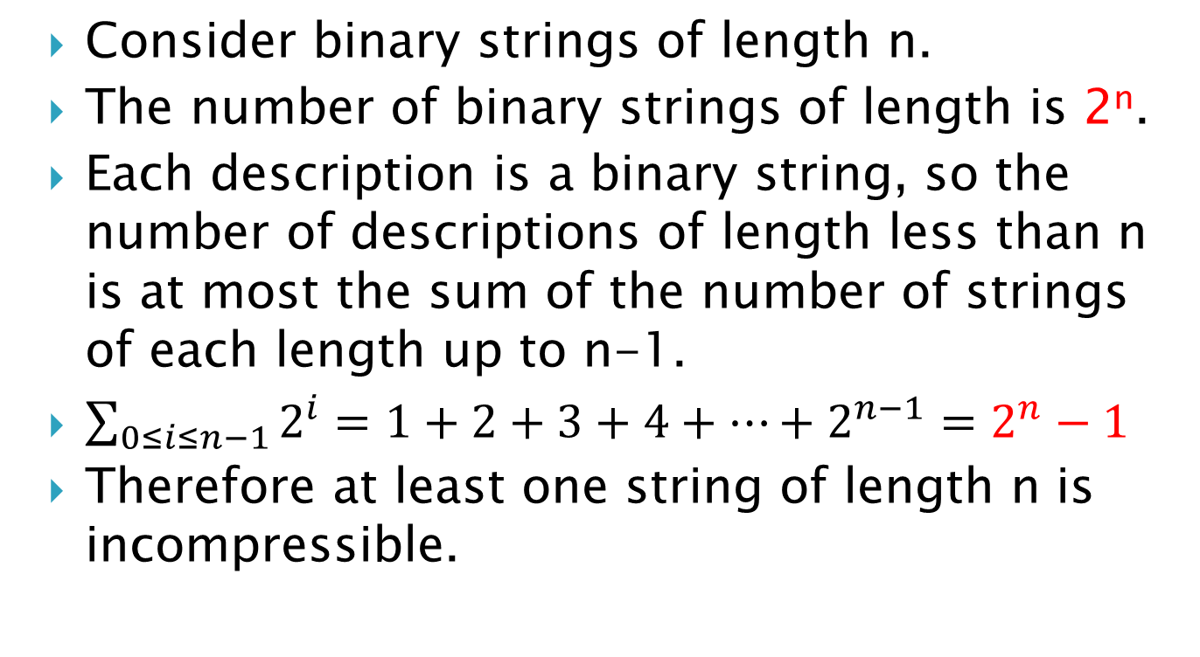
Example

Slide 17
Corollary
At least 2^{n}-2^{n-c+1}+1 strings of length n are incompressible by c.
Proof:
At most 2^{n-c+1}-1 strings of length n are c-compressible, because at most that many descriptions of length at most n-c exist.
The remaining 2^{n}-(2^{n-c+1}-1) are incompressible by c.

